Slide 1



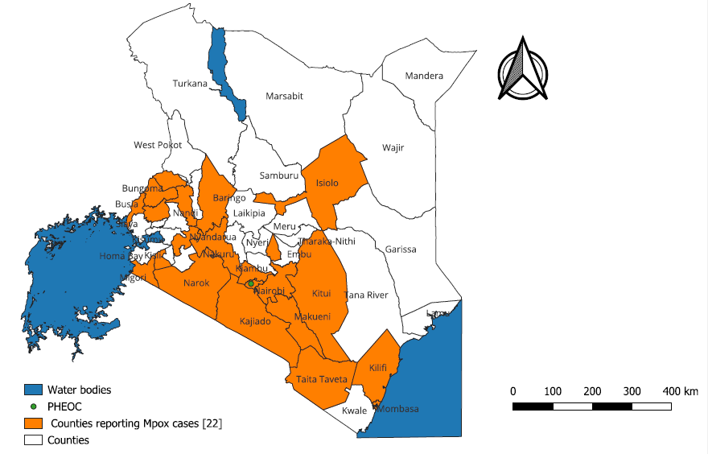



From Borders to Communities: Tracking the spread and effect of the Mpox outbreak in Kenya, 2024–2025
Raphael C. Nyawa^{1,2} , M. Njiru^{1,2} B. Waweru^{1,4}, A. Mwatondo^{1,3}, J. Gituku^{1,3}, H. Gatakaa^{1,4}, K. Ogello^{1,2}, C. Cheptoo^{1,2}, I. Umuro^{1,2}, M. Njuguna^{1,2}, W. Komu⁴, and M. Owiny^{1,3}
1: Field Epidemiology and Laboratory Training Program (FELTP), Kenya. 2: School of Public Health and Medical Statistics, Moi University, Kenya 3: African Fiend Epidemiology Network, 4: Ministry of Health, Kenya
BACKGROUND
Kenya recorded an index mpox case on July 31, 2024; in a border-town—Taita-Taveta. Subsequently, transmission spread to other counties, taking a community dimension. The investigation described twelve months of mpox outbreak to guide strategic interventions.
OBJECTIVE: To determine the drivers and practices supporting spread of Mpox in Kenya between July 2024 to July 2025..
METHODOLOGY:
.We conducted a deep dive analysis on all mpox cases in Kenya from July 2024 through July 2025. The data were obtained from the public health emergency operation centres, and national and subnational laboratories. An mpox cases were individual with laboratory positive real-time polymerase chain reaction test results. We analysed data through descriptive statistics.
STUDY AREA: Kenya
STUDY DESIGN, SAMPLING AND CASE DEFINITION
We retrieved Mpox records from; laboratory logs at the national virology reference laboratory (NVRL), regular situational reports (SITREPS), line-lists as well as alert diagnosis and management (ADaM) online surveillance system platform for the period from 1st July 2024 to 31st July 2025. The SITREP data abstracted was six months’ duration apart for the months of July 2024, January 2025 and July 2025 to show dynamics of spread in populations. We obtained individual Mpox line-lists from Mombasa, Busia and Nakuru Counties to fill gaps on missing variables, merged the data and created a national line-list.
An Mpox Case was defined as a person of any age presenting with an unexplained acute rash and one or more of the following signs or symptoms: headache, acute onset of fever (>38.5oC), lymphadenopathy (swollen lymph nodes), myalgia (muscle pain/body aches), back pain, asthenia (profound weakness) and with laboratory detection of MPXV DNA using either; real-time polymerase chain reaction (PCR) and/or DNA sequencing (10).
Figure 1: Map of Kenya showing 22 counties affected by Mpox disease on 31st July 2025
STATISTICAL ANALYSIS: The data was analysed by frequencies, proportions and geographical positioning. Fisher’s exact test was used to check for associations between death outcome and co-morbidity exposures among cases. The findings were presented in narratives, graphs, tables and maps.
RESULTS
DISCUSSION
There were 905 samples tested and Mpox virus was detected on 314 (34.7%) between July 31, 2024–July 31, 2025. The mean age of cases was 32±11 years, majority (267) 85% 20-49 years’ age and males were 161 (51%). Mpox case fatality rate was 1.6% (5/314). Mpox was reported among 22/47 (46.8%) Counties. Travel history among 16 (25%) cases was linked to Uganda, Rwanda and Democratic Republic of Congo. As January 31, 2025, the country had reported 37 cases with one death affecting 17 Counties by 31st January and 314 cases, five death affecting 22 Counties by July of 2025. Mpox spread shifted in the following order among truck drivers, female sex workers and community members from 40%, 40% and 20% on 31st Aug 2024 among 5 cases to 15 (6.1%), 10 (4%) and 222 (89.9%) on 31st July 2025 among 247 cases. There were 31 co-morbidities among 247 (78.7%) cases—HIV 23 (74.2%), hypertension 3 (9.7%) and diabetes 2 (6.5%) with four (12.9%) death. HIV complications caused 3 (9.7%) co-morbidity death.
The spread of Mpox in the year 2025 took a community spread trajectory driven by population dynamics, socio-cultural, economic and literacy levels. Given the infection trends, there was an imminent risk of Mpox escalation and bigger outbreak risking individuals living in semi-permanent settlements where uncontrolled sexual habits were common. Children as well as people living with HIV and other immunocompromised individuals were predisposed to the severe effects of Mpox including permanent disability and death. Given the expensive nature of the disease management; long period of isolation of twenty-one days and which could be longer for patients with severe forms, the government of Kenya was likely to be overwhelmed.
This therefore, called for collaborative efforts among partners to disrupt the transmission chains and control the disease at the earliest opportunity. Given the increasing populations at risk in Kenya as denoted by this study, there was an urgent need to plan for mass vaccination campaign on groups in counties at higher risk Counties such as Mombasa, Busia, Nairobi and Kilifi along the Northern transport corridor. This would build herd immunity, cut down the transmission chain and control the disease which was becoming endemic in Kenya.
Table 1: Age and occupation characterization of Mpox in Kenya, July 2025
Age-group | Boda-boda rider | Casual laborer | Child | Truck Driver | Professional | Self -employed | Female sex-worker | Student | Unemployed | Total | Proportions
0-4 | 0 | 0 | 7 | 0 | 0 | 0 | 0 | 0 | 0 | 7 | 2.8%
5-12 | 0 | 0 | 8 | 0 | 0 | 0 | 0 | 2 | 2 | 12 | 4.9%
13-19 | 0 | 0 | 1 | 0 | 0 | 1 | 1 | 5 | 1 | 9 | 3.6%
20-35 | 1 | 7 | 0 | 4 | 7 | 34 | 5 | 3 | 67 | 128 | 51.8%
36-49 | 0 | 4 | 0 | 10 | 10 | 14 | 3 | 0 | 41 | 82 | 33.2%
50-70 | 0 | 1 | 0 | 1 | 1 | 1 | 1 | 0 | 3 | 8 | 3.2%
71-90 | 0 | 0 | 0 | 0 | 0 | 0 | 0 | 0 | 1 | 1 | 0.4%
Total | 1 | 12 | 16 | 15 | 18 | 50 | 10 | 10 | 115 | 247
Proportion | 0.4% | 4.9% | 6.5% | 6.1% | 7.3% | 20.2% | 4.0% | 4.0% | 46.6%
CONCLUSIONS
Mpox spread patterns in Kenya saw a shift from key populations to the general community. HIV-patients predisposed to severe mpox outcomes.
The report generated recommendations for public health actors, to target interventions—sensitizations, mpox vaccinations and strengthen surveillance.
Contact: Dr. Raphael Chimweli Nyawa. Email: raphael.nyawa@yahoo.com

